Slide 1
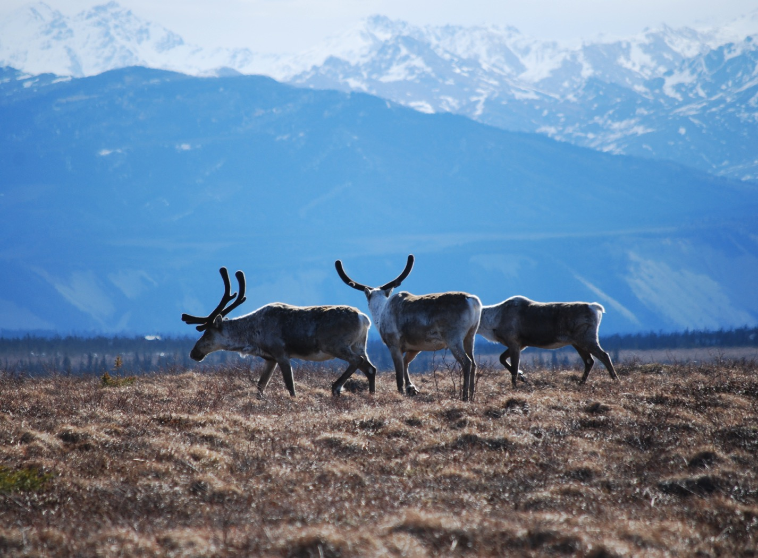
Arctic Boreal Vulnerability Experiment (ABoVE)
2017 ABoVE Airborne Campaign
16 August 2017 (DOY 228)
AirSWOT/Ka-SPAR Campaign #2:
BERMS/Saskatoon Joint Ground-Air Campaign
Charles Miller, Deputy Science Lead
Jet Propulsion Laboratory, California Institute of Technology
and the ABoVE Science Team For Hank Margolis, Eric Kasichke, Bruce Tagg
NASA HQ
2017

Slide 2
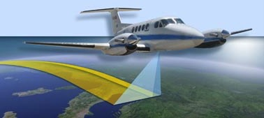
16 August 2017/DOY 228 Saskatoon Joint Ground-Air Campaign
Daily Status: AirSWOT / N801NA ABoVE CAMPAIGN (CANADA / ALASKA)
REPORT DATE: 6 August 2017
Current Status of Aircraft: GREEN
Current Status of Radar: GREEN
Current Status of Camera: GREEN
IMU issue during last line, but otherwise good. Problem likely avoidable via procedure in future flights.
Current Status of Crew: GREEN
Current Deployment Location: Saskatoon SK (CYXE)
Crew: Howe, Phelps, Haynes
Science Coordinators: T Pavelsky, C Rains
Science Lead: L Smith
Project Manager: Y Lou

Slide 3
16 August 2017/DOY 228 Saskatoon Joint Ground-Air Campaign
Science Operations Summary:
Flew Science Lines (south of CYMM, and Priority “BERMS” lines in vicinity of Saskatoon. – 5.9 hours (
1.7 hr transit CYZF-CYMM, and 4.2 hr science mission CYMM-CYXE).
5 lines – good wx CYMM to Edmonton area; cloud cover most of line 2 between Edmonton and Saskatoon area; northern most Saskatoon line mostly cloud-free; priority line (#4) southwest 1/3 of line cloud covered; southern priority line (#5) northwest half mostly obscured by clouds.
PLAN IS TO REFLY 2 PRIORITY LINES on 8/17.
No system/radar/camera issues.
Successful mission.
Flight Plan PAVE_0075: https://flightplanning.jpl.nasa.gov/cgi-bin/report.pl?planID=pavelky_0075#map

Slide 4
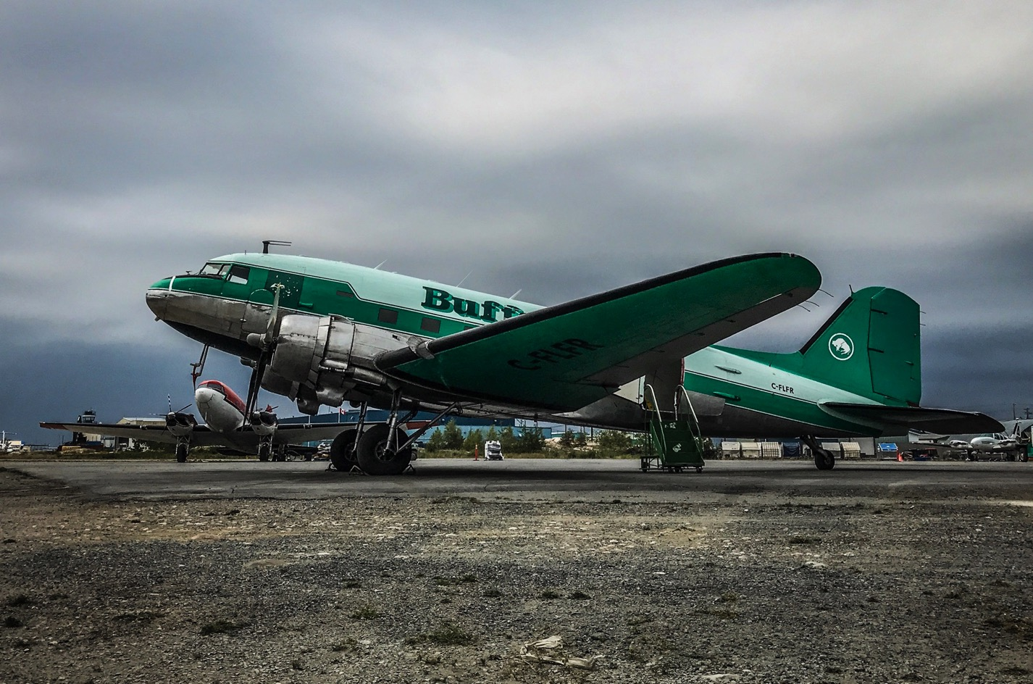
16 August 2017/DOY 228 Saskatoon Joint Ground-Air Campaign
Fires in the southern Northwest Territories sending smoke across the Great Slave Lake Region
Notes:
Buffalo Air planes form the Yellowknife Aircraft Museum

Slide 5
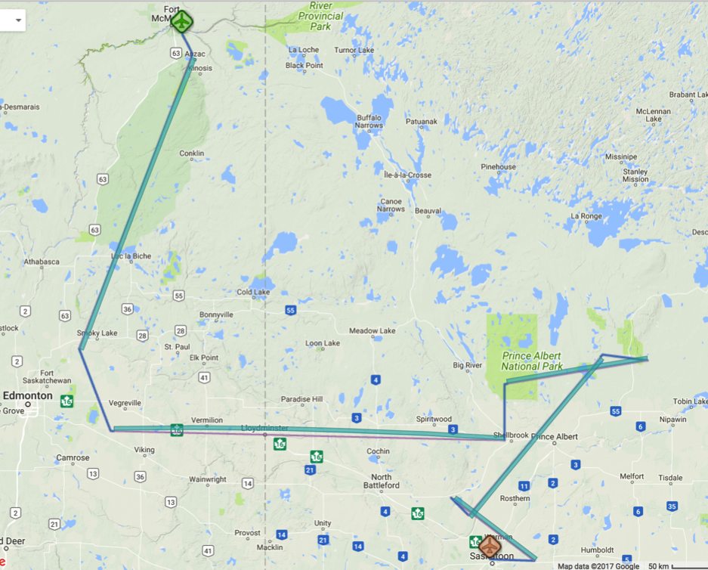
16 August 2017/DOY 228 Saskatoon Joint Ground-Air Campaign
Flight Plan: pavelky_0075 (Fort McMurray Saskatoon June 6)
https://flightplanning.jpl.nasa.gov/cgi-bin/report.pl?planID=pavelky_0075#summary
Flight plan pavelky_0075
Data Acquisitions:
Line 1 pave11_201aa
Line 2 pave02_091aa
Line 3 pave09_081ab
Line 4 pave01_220aa
Line 5 pave10_127aa
pave11_201aa
pave09_081aa
pave02_091aa
pave01_220aa
Pave11_201aa
Notes:
Started line 091 approx 1930Z

Slide 6
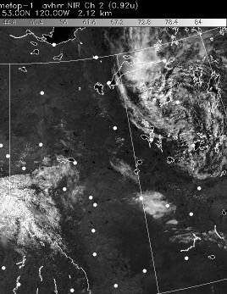
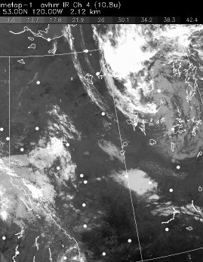
16 August 2017/DOY 228 Saskatoon Joint Ground-Air Campaign
Sortie #1
CYZF - CYMM
Sortie #1
CYZF - CYMM
HRPT Vis 1732Z
HRPT IR 1732Z
Notes:
Satellite imagery from the time of Sortie #1 shows mostly clear skies along the flight path with a large, dense cloud field to the east

Slide 7
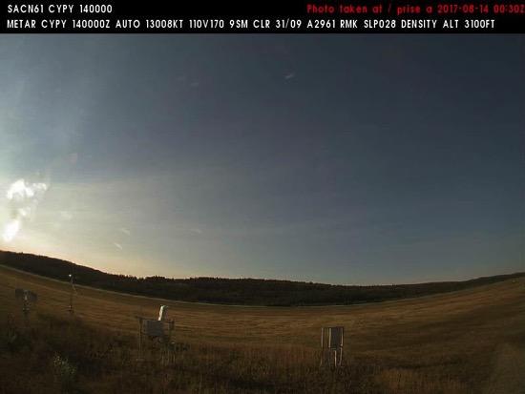
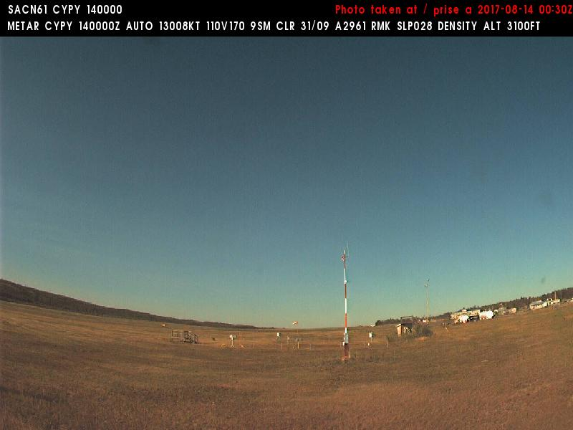
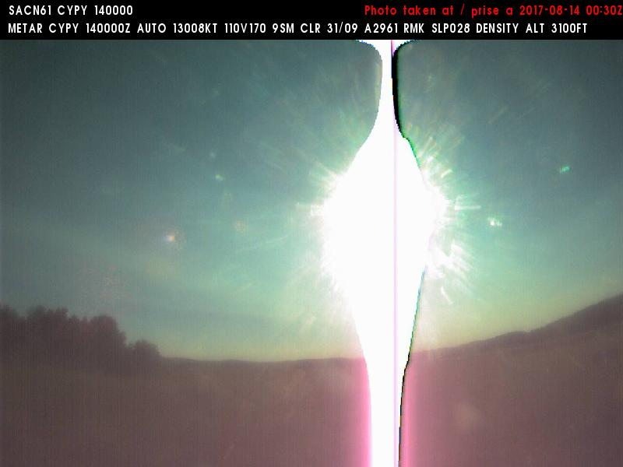
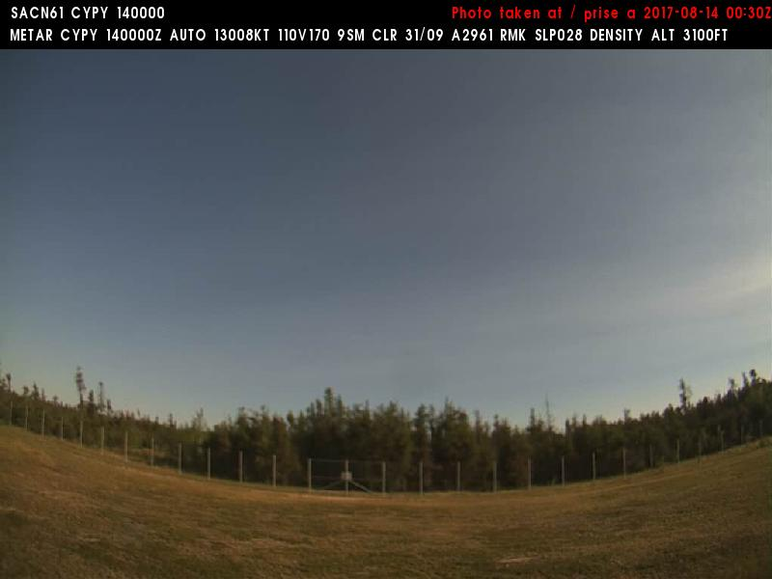
16 August 2017/DOY 228 Saskatoon Joint Ground-Air Campaign
Northwest
North
Nipawin (CYBU) N53 19 59 W104 00 14 Elev: ' MSL
Nipawin Aviation Cameras
West
Southeast
Notes:
Aviation Camera pictures from Nipawin SK during AirSWOT/N801NA overflight show bright blue skies and no hints of smoke

Slide 8
16 August 2017/DOY 228 Saskatoon Joint Ground-Air Campaign
Northwest
North
Nipawin (CYBU) N53 19 59 W104 00 14 Elev: ' MSL
Nipawin Aviation Cameras
West
Southeast
Notes:
Aviation Camera pictures from Nipawin SK during AirSWOT/N801NA overflight show bright blue skies and no hints of smoke

Slide 9
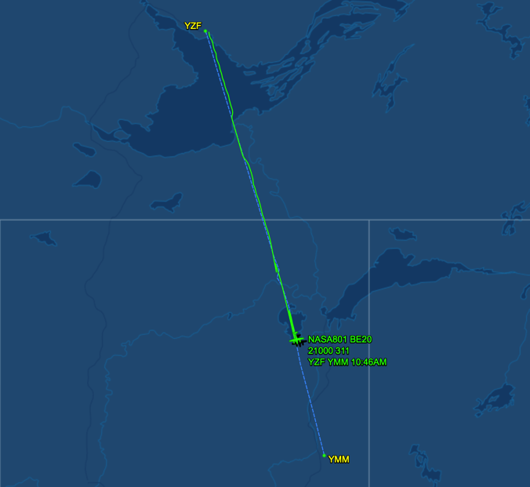
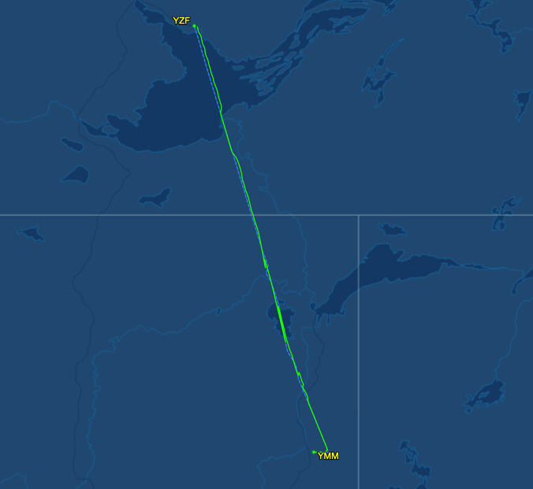
16 August 2017/DOY 228 Saskatoon Joint Ground-Air Campaign
As-flown Lines
Sortie #1
As-flown Lines
Sortie #1
1620Z – NASA 801 over PAD
1640Z – NASA 801 lands
@ Fort McMurray

Slide 10
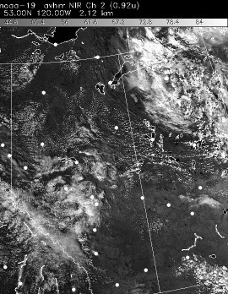
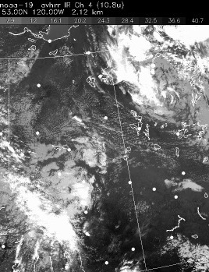
16 August 2017/DOY 228 Saskatoon Joint Ground-Air Campaign
HRPT Vis 2208Z
HRPT IR 2208Z
Notes:
Satellite imagery from near the end of the AirSWOT / NASA 801 Sortie #2. Partly cloudy to cloudy skies in the Saskatoon area

Slide 11
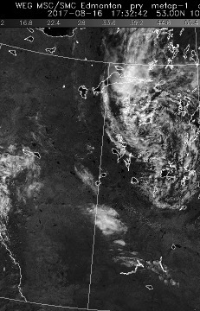
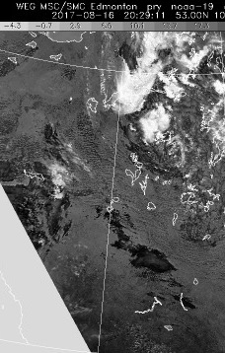
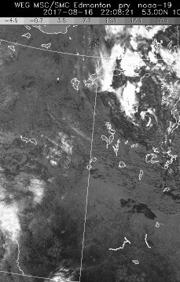
16 August 2017/DOY 228 Saskatoon Joint Ground-Air Campaign
HRPT 3 um 1732Z
HRPT 3 um 2029Z
HRPT 3 um 2208Z
Notes:
3 um band showing band of clouds moving from west to east along the Edmonton – Saskatoon transect during AirSWOT Sortie #2

Slide 12
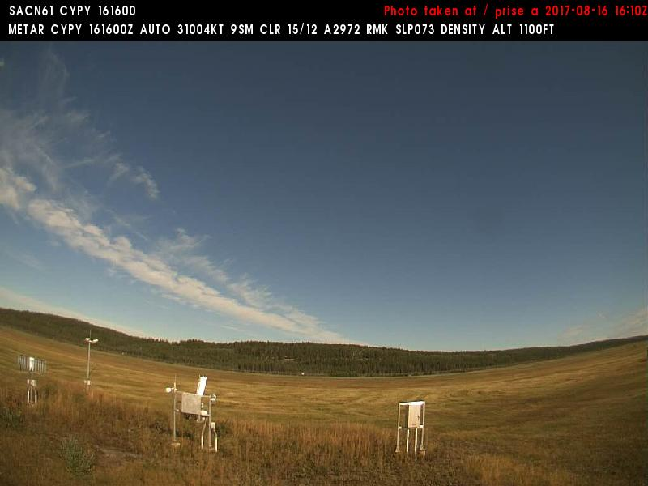
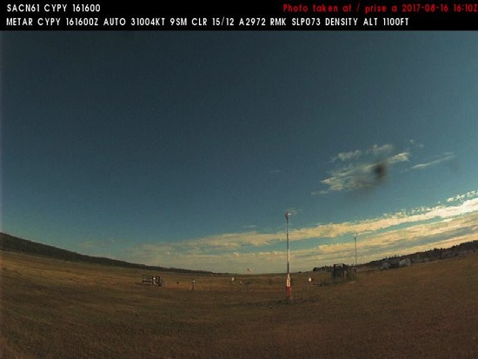
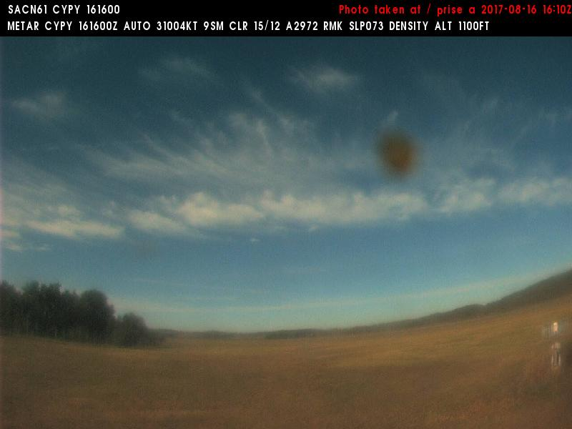
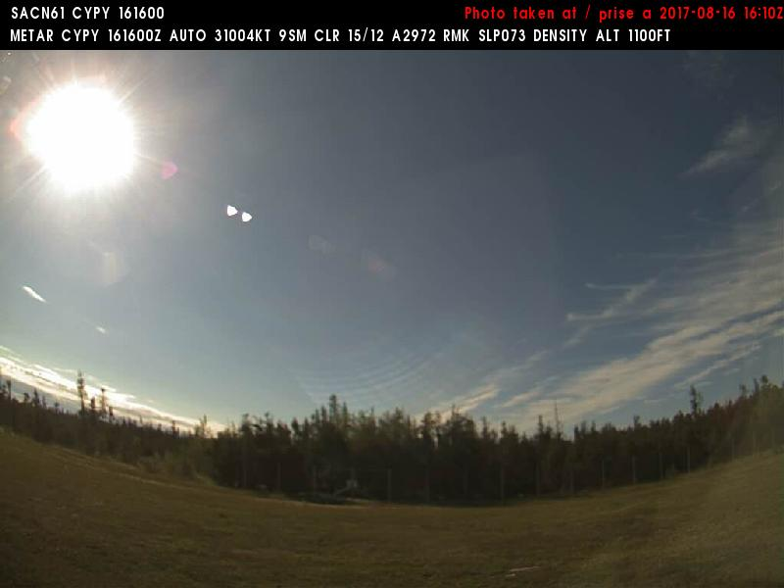
16 August 2017/DOY 228 Saskatoon Joint Ground-Air Campaign
Northwest
Northeast
Fort Chipewyan Airport (CYPY) N58 46 03 W111 07 03 ELEV: 761' MSL
Fort Chipewyan Aviation Cameras
West
Southeast
Notes:
Aviation Camera pictures from Fort Chipewyan during AirSWOT/N801NA overflight show bright blue skies and no hints of smoke

Slide 13
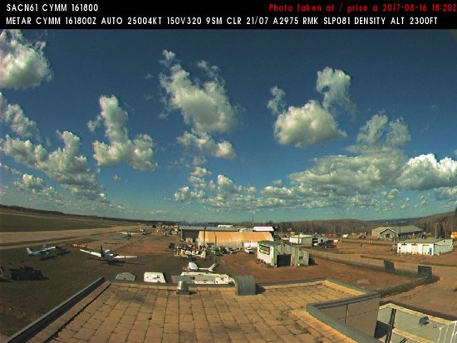
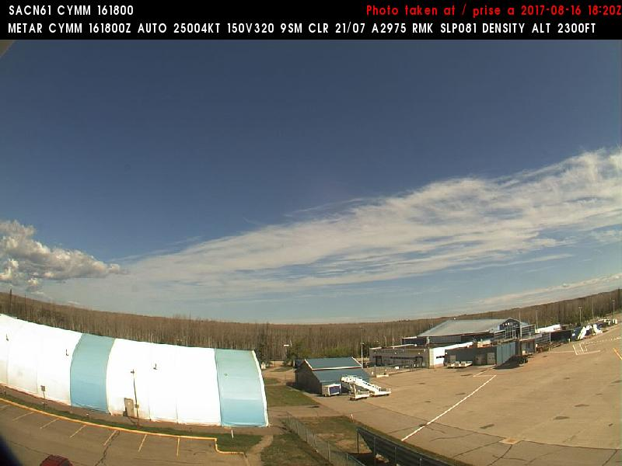
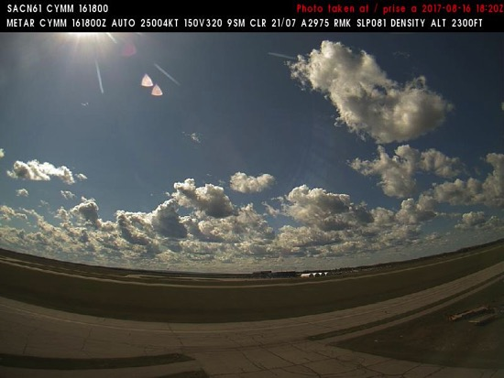
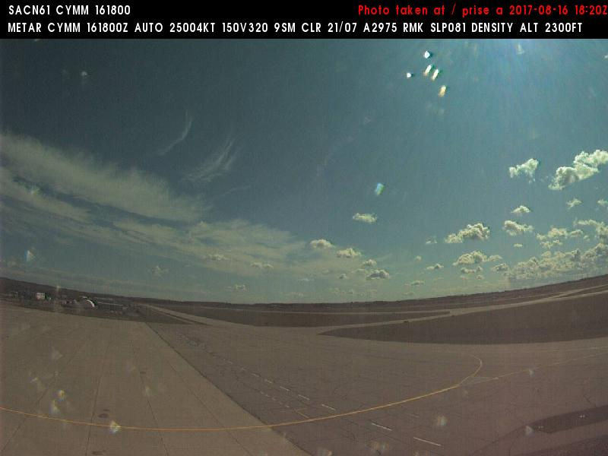
16 August 2017/DOY 228 Saskatoon Joint Ground-Air Campaign
Northwest
Northeast
Fort McMurray Airport (CYMM) N56 39 12 W111 13 24 ELEV: 1211' MSL
Fort McMurray Aviation Cameras
Southwest
Southeast
Notes:
Aviation Camera pictures from Fort McMurray during AirSWOT/N801NA departure (1820Z) for Edmonton and Saskatoon area show bright blue skies and some high clouds with no smoke

Slide 14
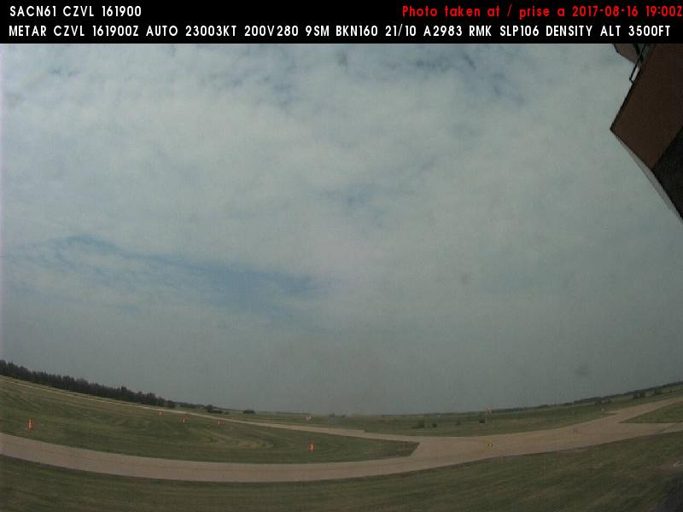
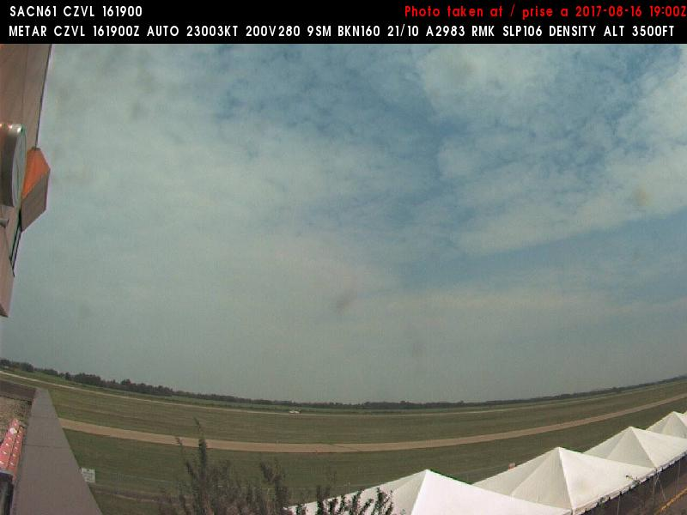
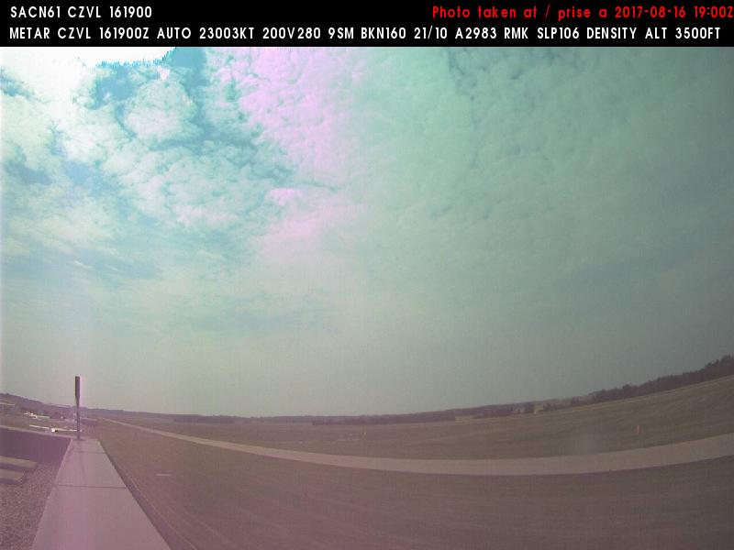
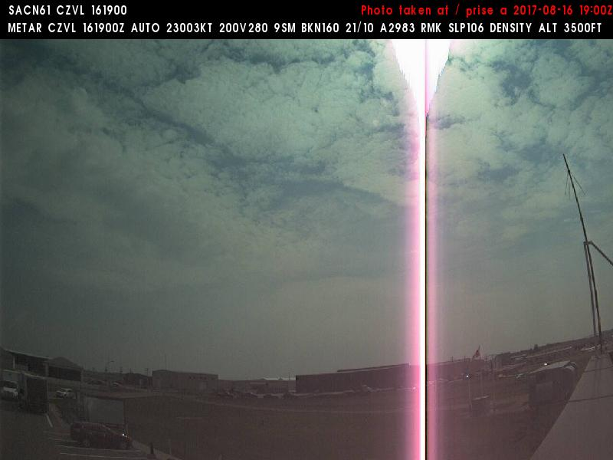
16 August 2017/DOY 228 Saskatoon Joint Ground-Air Campaign
Northwest
Northeast
Edmonton / Villeneuve (CZVL) N53 40 06 W113 51 08 ELEV: 2256' MSL
Edmonton/Villeneuve Aviation Cameras
Southwest
Southeast
Notes:
Aviation Camera pictures from Edmonton/Villeneuve during AirSWOT/N801NA overflight (1900Z) show mostly cloudy skies

Slide 15
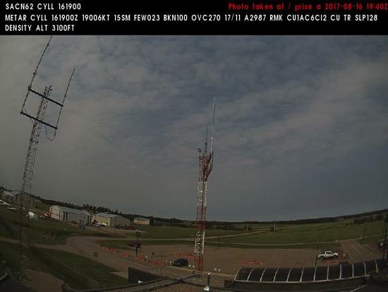
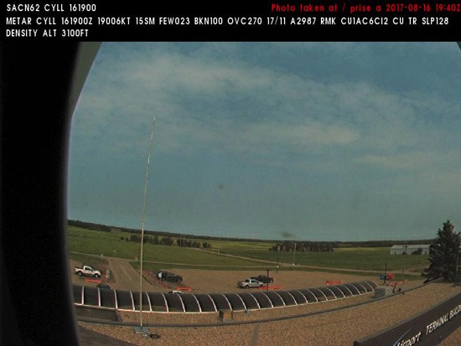
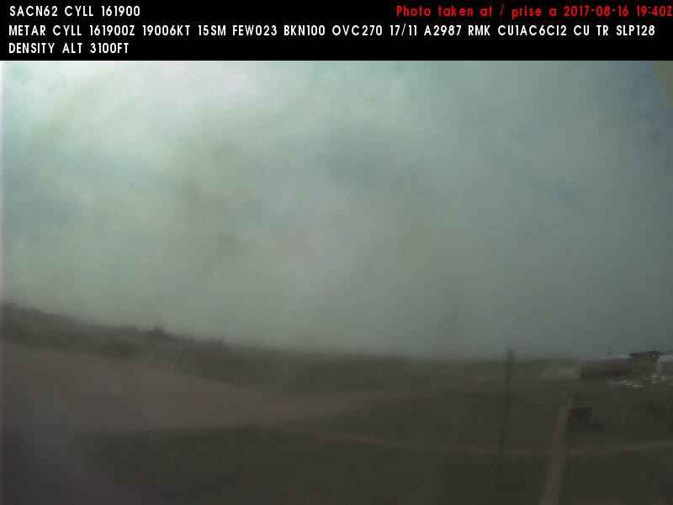
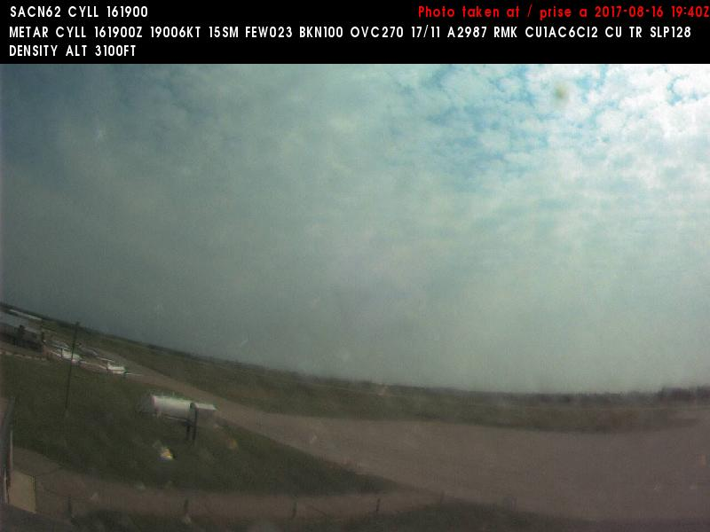
16 August 2017/DOY 228 Saskatoon Joint Ground-Air Campaign
Northwest
Northeast
Lloydminster Airport (CYLL) N53 18 33 W110 04 21 ELEV: 2194' MSL
Llyodminster Aviation Cameras
West
Southeast
Notes:
Aviation Camera pictures from Lloydminster during AirSWOT/N801NA overflight (~1945Z) – a band of low clouds moving through the area

Slide 16
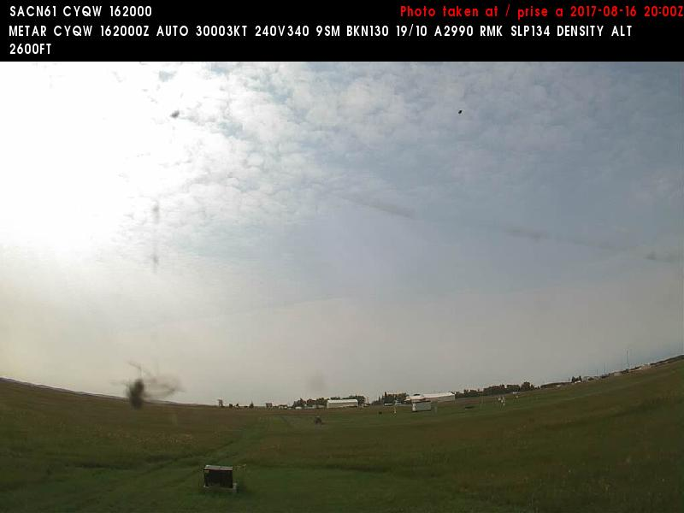
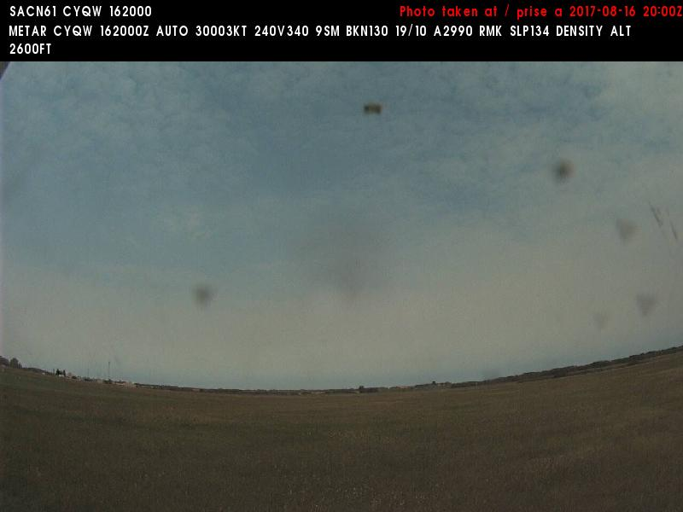
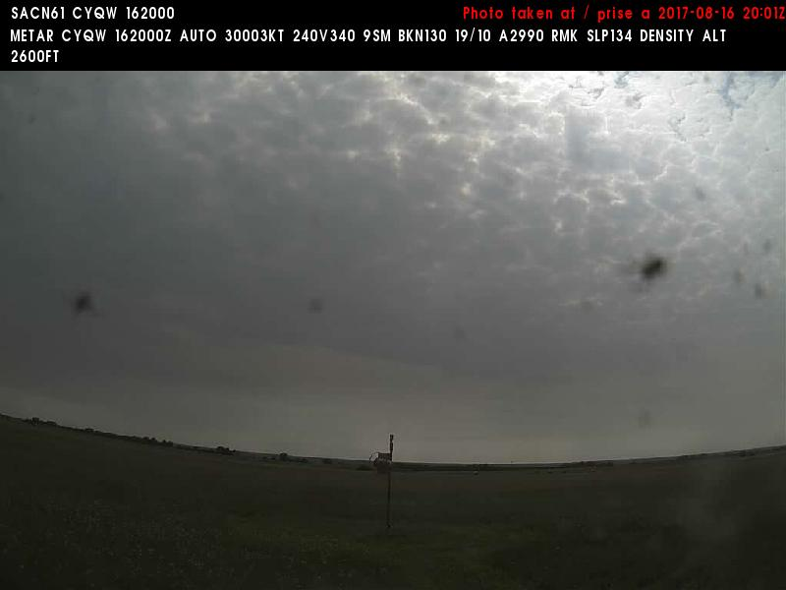
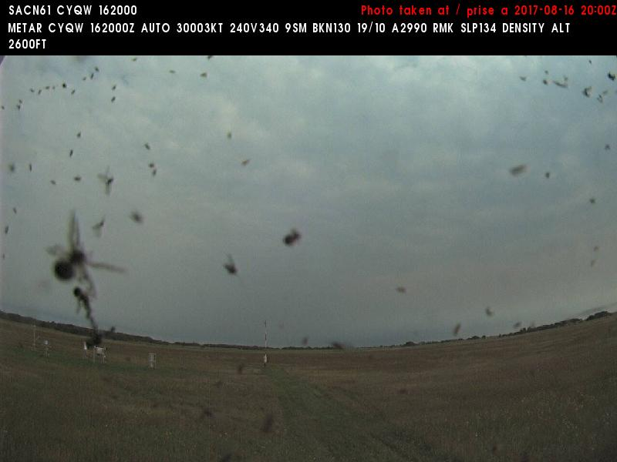
16 August 2017/DOY 228 Saskatoon Joint Ground-Air Campaign
West
North
North Battleford (CYQW) N52 46 09 W108 14 37 Airport ELEV: 1799'
North Battleford Aviation Cameras
South
East
Notes:
Aviation Camera pictures from North Battleford SK during AirSWOT/N801NA overflight (~2000Z) show a band of low clouds obscuring 80-100% of the sky.
Worse to the south and west

Slide 17
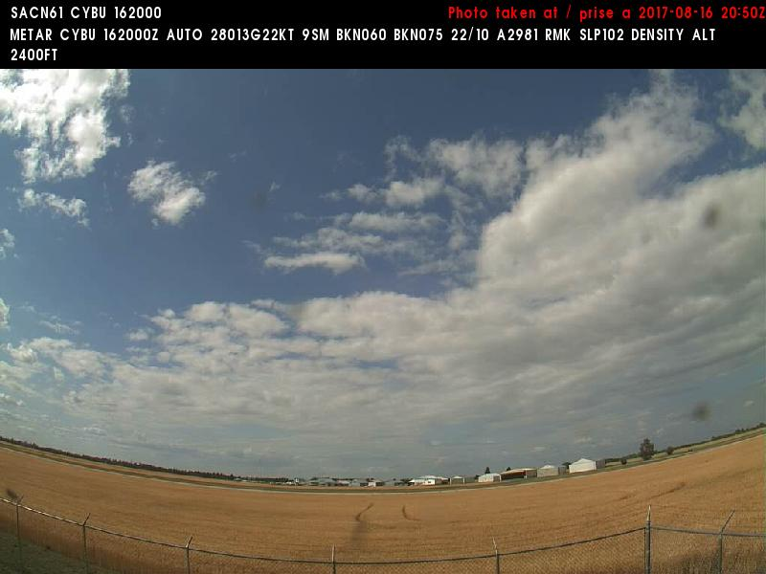
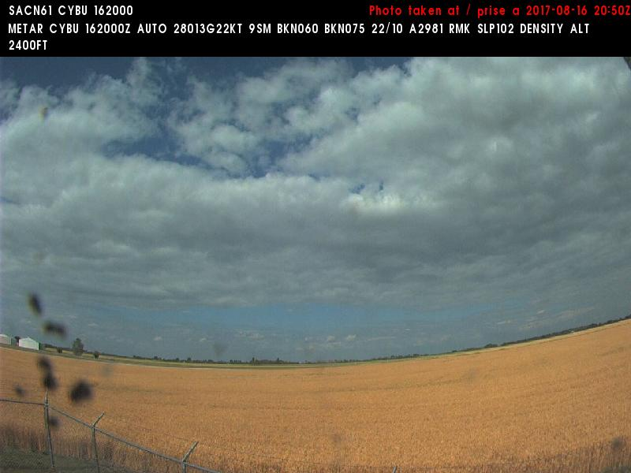
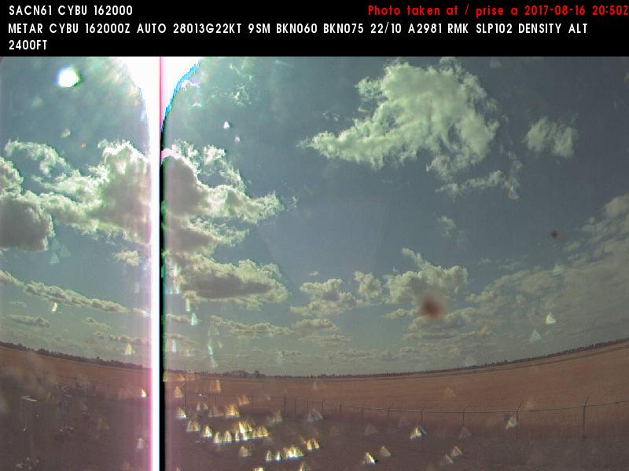
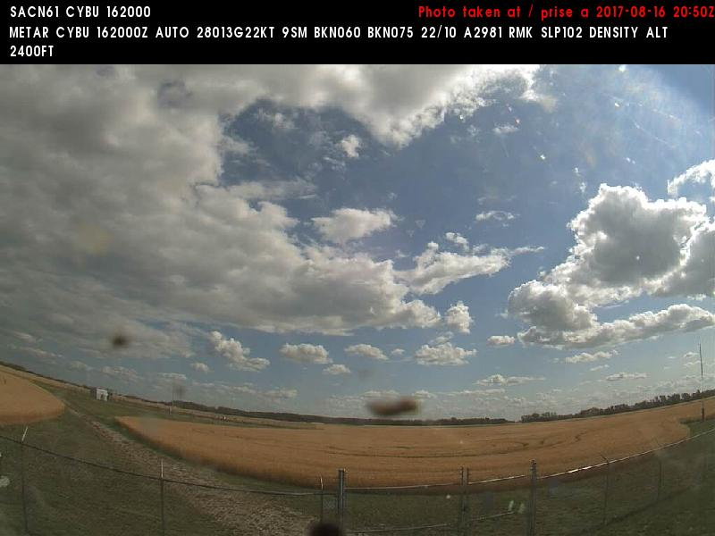
16 August 2017/DOY 228 Saskatoon Joint Ground-Air Campaign
Northwest
North
Nipawin (CYBU) N53 19 59 W104 00 14 Elev: ' MSL
Nipawin Aviation Cameras
West
Southeast
Notes:
Aviation Camera pictures from Nipawin SK during AVIRIS/N53W overflight of the region (2050Z) show clearing to the west but still mostly cloudy to the north and east

Slide 18
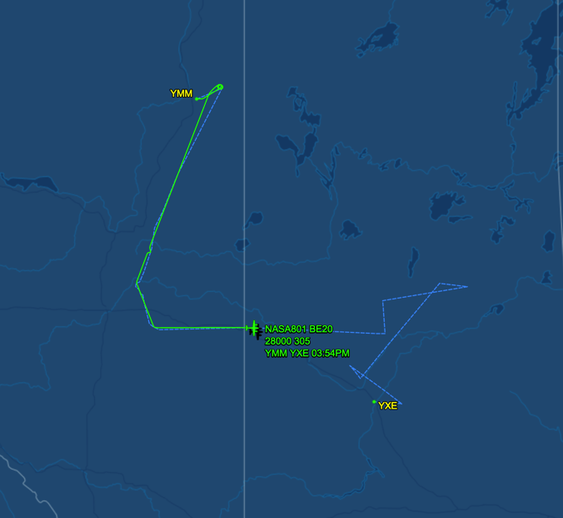
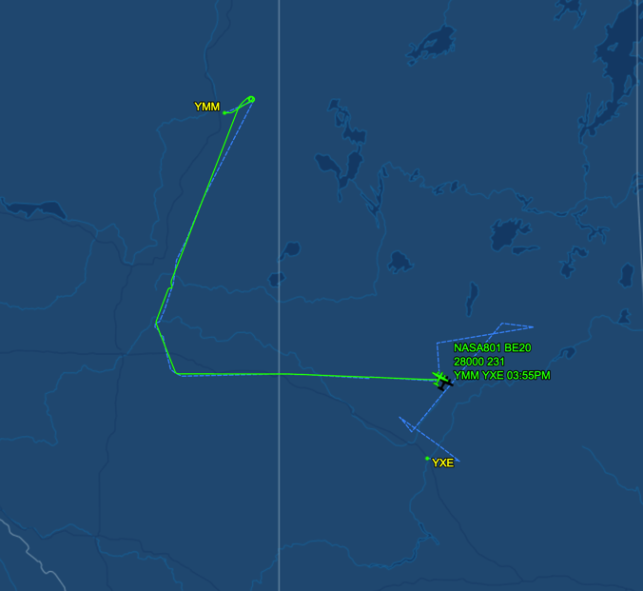
16 August 2017/DOY 228 Saskatoon Joint Ground-Air Campaign
As-flown Lines
Sortie #2
As-flown Lines
Sortie #2
1945Z – NASA 801 over Lloydminster
2017Z – NASA 801 finishes
Lloydminster line
Notes:
AirSWOT starts line pave_220aa ~2050Z

Slide 19
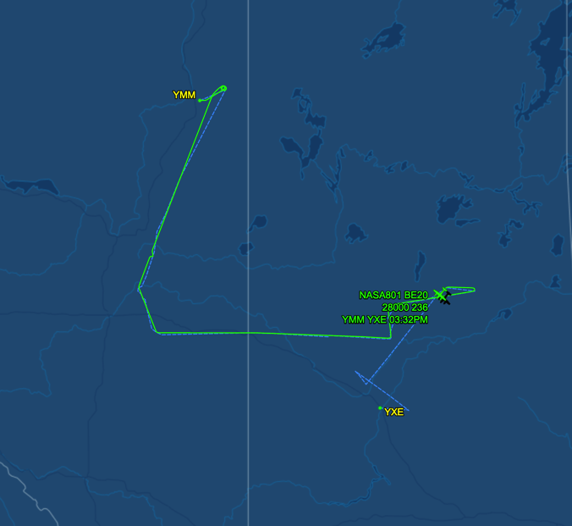
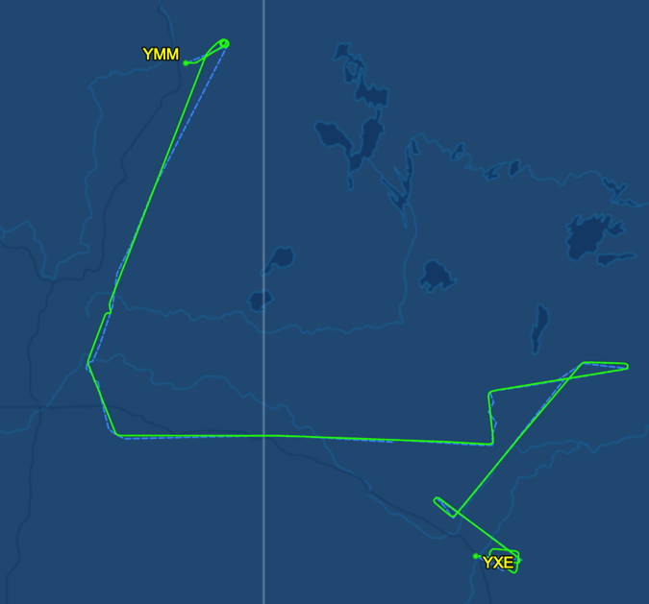
16 August 2017/DOY 228 Saskatoon Joint Ground-Air Campaign
As-flown Lines
As-flown Lines
2055Z – NASA 801 over starting Line pave01_220aa
2149Z – NASA 801 completes
Sortie #2
Notes:
AirSWOT starts line pave_220aa ~2050Z
AirSWOT completes sortie #2 ~2150Z

Slide 20
16 August 2017/DOY 228 Saskatoon Joint Ground-Air Campaign
Quick-look products to be generated
UPDATE

Slide 21
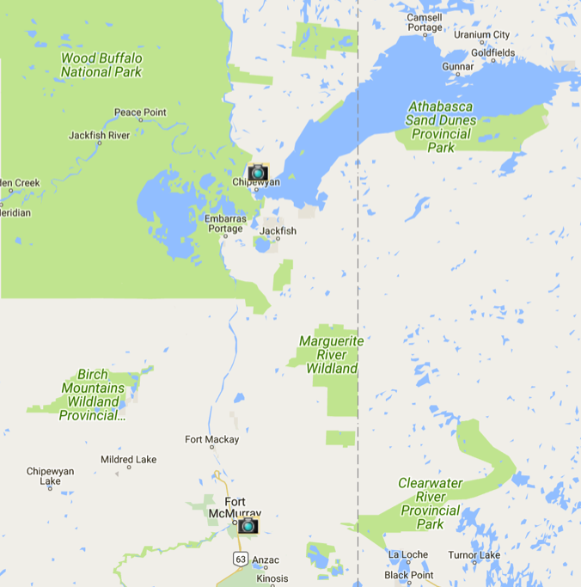
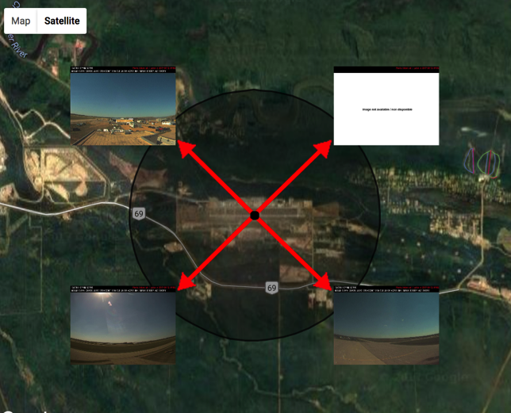
16 August 2017/DOY 228 Saskatoon Joint Ground-Air Campaign
Fort McMurray Aviation Cameras
Notes:
Aviation Camera pictures from Fort Chipewyan

Slide 22
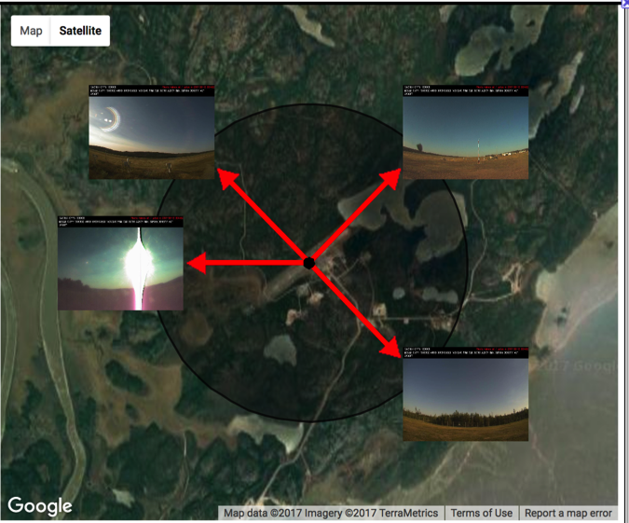
16 August 2017/DOY 228 Saskatoon Joint Ground-Air Campaign
Fort Chipewyan Aviation Cameras
Notes:
Aviation Camera pictures from Fort Chipewyan

